Slide 1
Calpod Configuration Guide
Calpod configuration information
John Swanstrom
November 6, 2012
Notes:
This Calpod configuration guide provides guidance on how to configure Calpod systems for various measurement configurations. It primarily addresses the control cabling necessary for controlling the Calpods. This document is provided to assist in configuring a Calpod system for a customer to ensure that the customer gets a quotation and orders all the necessary cabling and components for their measurement needs.
The User’s Guide (p/n 85523-90001) provides information on setting up and configuring the Calpod hardware and software and using the Calpods.

Slide 2
Calibration Refresh Modules (Calpods)
Applications that benefit from the new calibration refresh modules:
Thermal vacuum testing
Temperature chamber testing
Measurement of low-loss devices
Very accurate phase measurements
Applications that require frequent recalibrations
Provide the closest device tolerances in production testing
Applications that have complex and lengthy calibrations, such as multi—ort measurement
Measurement of cables installed in aircraft
Remove switch matrix repeatability errors
Remove switch and connector repeatability errors in complex ATE test systems
Agilent Technologies 855xxA Series calibration refresh modules, also know as Calpods, provide a new and unique way to quickly and easily refresh a network analyzer calibration.
Have you ever wondered right before making a measurement, “is this calibration still valid?” In the middle of a very long testing sequence or when making a critical measurement is not the time to be concerned about whether or not the calibration is still valid! With calibration refresh modules, you can be assured of a valid calibration quickly – at the simple touch of a button, without removing the DUT, and without the physical connection of calibration standards.

Slide 3
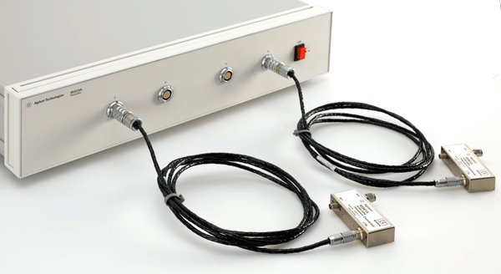
CalPods: Calibration Refresh Modules
CalPod controller
CalPod control cables
2 m lengths, optional 10 m extensions up to 30 meters
CalPods
100 MHz to 20 GHz or
500 MHz to 40 GHz
Notes:
The CalPod calibration refresh modules come in two different frequency ranges. The lower frequency CalPods operate from 100 MHz to 20 GHz, and the higher frequency CalPods operate from 500 MHz to 40 GHz.
A CalPod controller is required to control the operation of the CalPods, and provides the DC voltages required by the CalPods, as well as the control signals for the CalPods.
The CalPod control cables are used to carry the control signals between the controller and the CalPods, as well as the DC voltages required by the CalPods. The low frequency and higher frequency CalPods required different DC voltages, and thus there are different cables required for the different CalPods. The CalPod control cable connectors are keyed so that only the proper control cable will plug in to the respective CalPod.

Slide 4
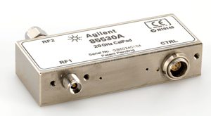
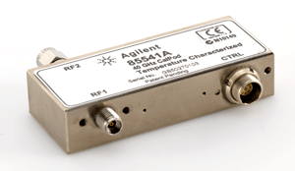
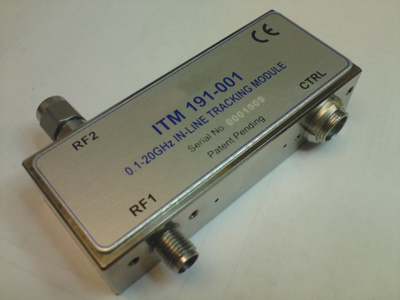
Types of CalPods
Ambient temperature CalPods
For bench top and ambient measurement applications
85530A 20 GHz ambient CalPod module
85540A 40 GHz ambient CalPod module
Temperature compensated CalPods
For hot plate & temperature chamber applications
85531A 20 GHz Temperature compensated CalPod module
85541A 40 GHz Temperature compensated CalPod module
Thermal Vacuum CalPods
For thermal vacuum chamber applications
85532A 20 GHz Thermal-vacuum environment Calpod
85542A 40 GHz Thermal-vacuum environment Calpod
Performance similar to temp. compensated CalPods
Not a current photo…
New photo coming…
Will look exactly like above photos
Notes:
The CalPods are available in three different types depending on the application:
Ambient temperature CalPods are typically used in bench top measurement applications where accurate measurements are desired, and where accurate calibrations are desired before each measurement. Example measurements are very low loss devices, where the cable movement between performing the calibration and then connecting to the DUT might have a significant change to the measured value. Another application is where productivity in production testing is desired. Rather than taking the time to periodically recalibrate the measurement system using an ECal module, a quick calibration refresh could be performed with the CalPods.
Temperature compensated CalPods are typically used for measurements that are performed in a temperature chamber or on a hot plate on a bench top where the DUT needs to be tested over a range of temperatures. These types of thermal testing typically stretch over a longer time duration. The temperature compensated CalPods are thermally characterized over a -30 °C to +80°C temperature range, and provide accurate calibration refresh corrections over this temperature range.
Thermal-vacuum environment CalPods are typically used in thermal vacuum environments, operate over the same temperature range as the thermally characterized CalPods, and are suitable for hard vacuum environments, and do not out gas in a hard vacuum. They have the same performance as the temperature compensated Calpods.

Slide 5
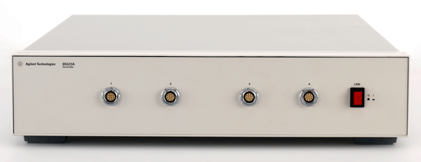
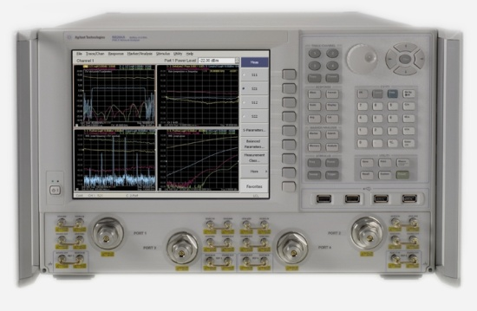
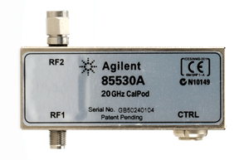
Basic CalPod Configuration for a two-port DUT
85523A CalPod Controller
CalPod Control Cables
Every CalPod unit needs a CalPod control cable, ordered separately as shown below:
For the 20 GHz CalPods,
use 85552A 20 GHz CalPod drive cable;
(2 meters in length)
For the 40 GHz CalPods,
use 85553A 40 GHz CalPod drive cable;
(2 meters in length)
Microwave
test cables
DUT
CalPods
85530A 20 GHz Ambient temperature CalPod module
85531A 20 GHz Temperature compensated CalPod module
85532A 20 GHz Thermal-vacuum environment Calpod module
85540A 40 GHz Ambient temperature CalPod module
85541A 40 GHz Temperature compensated CalPod module
85542A 40 GHz Thermal-vacuum environment Calpod module
Calibration & Test
Reference
plane

Slide 6

CalPod Product Descriptions
Items | Description | Price
PNA option 301/302 | Ambient/Temp Co Software for CalPod | $5K/10K
PNA option 303 | Multiport Software for Cal Pod (later release) | $10K
85523A | Controller | $6K
85530A | 20 GHz Ambient CalPod Module | $4.0K
85531A | 20 GHz Temperature Compensated CalPod Module | $4.5K
85532A | 20 GHz Thermal-vacuum environment Calpod module | $7.0K
85540A | 40 GHz Ambient CalPod Module | $6K
85541A | 40 GHz Temperature Compensated CalPod Module | $7K
85542A | 40 GHz Thermal-vacuum environment Calpod module | $10.2K
85552A | 2 Meter 20 GHz CalPod drive cable | $575
85553A | 2 Meter 40 GHz CalPod drive cable | $575
85554A | 10 Meter CalPod drive cable extension | $1000
85555A | Splitter Drive Cable 2M | $800
85556A | 1X12 Fan out Cable Splitter | $4600
Notes:
The prices shown are USD reference prices, and can be used for budgetary pricing.

Slide 7
Basic Configuration for a Four-port DUT ≤ 2 meters from Controller to CalPods
Thermal Chamber
DUT
USB to LAN interface
Microwave test cables
CalPod control cables
When the distance between the CalPod controller and the CalPod units are 2 meters or less, can use the 85552A or 85553A CalPod drive cables directly.

Slide 8
Basic Configuration for up to a Four-port DUT
≥ 2 meters from Controller to CalPods
Thermal Chamber
DUT
Microwave test cables
USB to LAN interface
85554A Extension cable for CalPod drive cables
10 meter length, male-to-female connectors
Can be cascaded for longer lengths
85552A (20 GHz) & 85553A (40 GHz)
CalPod control cables

Slide 9
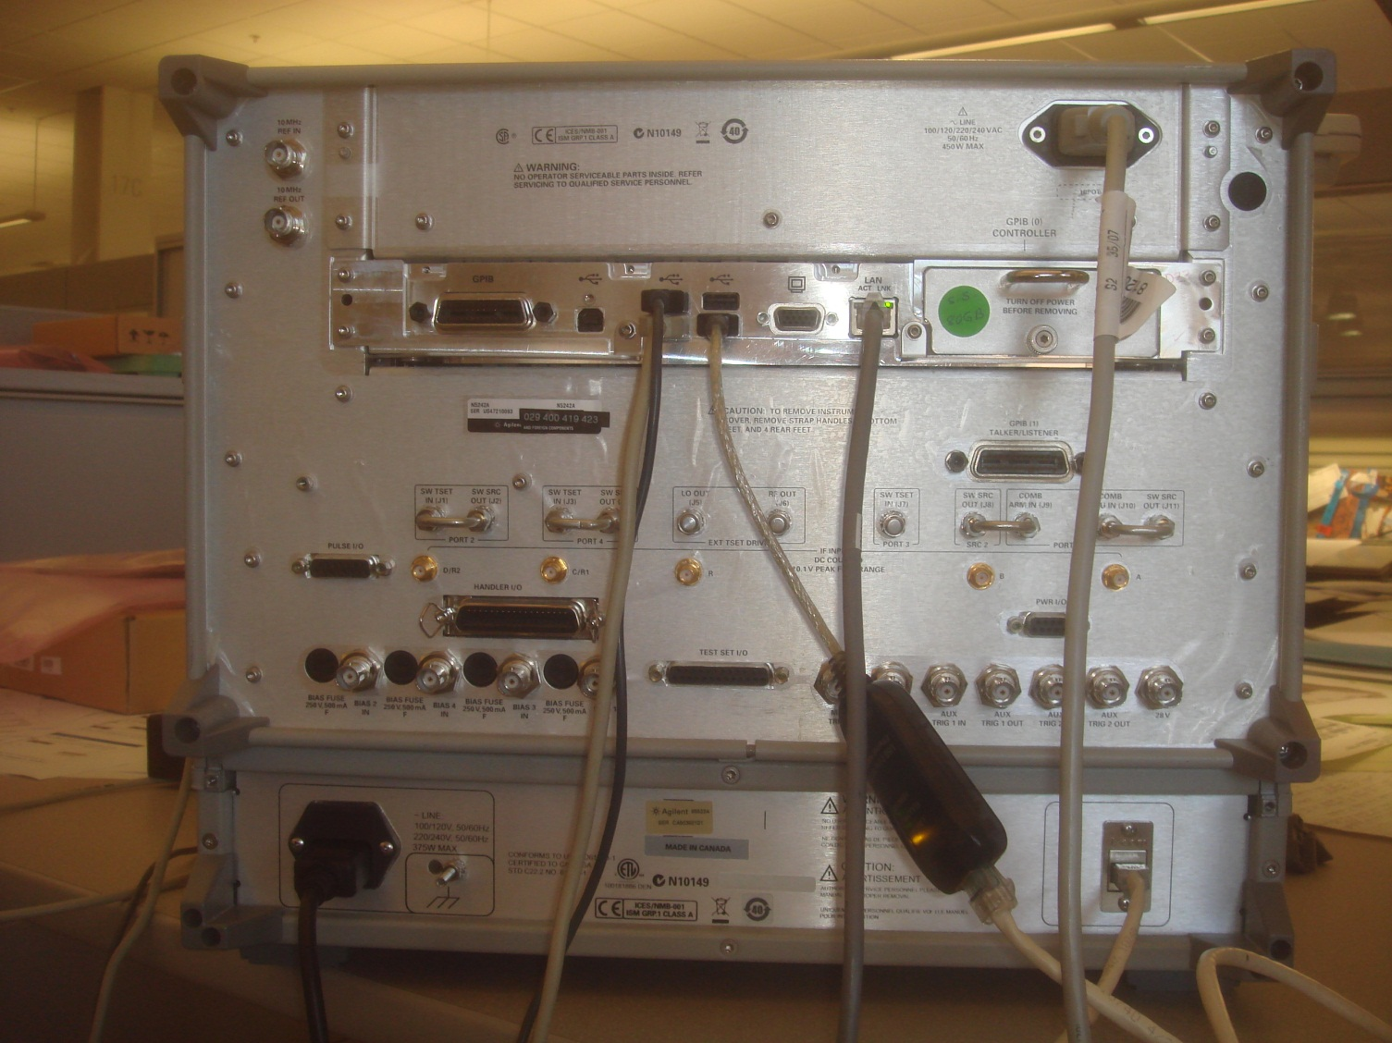
PNA to 85523A CalPod Controller Communication
PNA
Network LAN
USB connection to PNA
USB 2.0 to
10/100 Ethernet Adapter
85523A Calpod Controller
LAN connection to 85523A Calpod controller
Notes:
Calpod controller communication is accomplished via a USB-LAN module, which is included with the 85523A Calpod controller. For this application Agilent uses the Cables to Go USB 2.0 Fast Ethernet Adapter (model # 39998 from Cables To Go www.cablestogo.com) or can be ordered from Agilent with part number 0960-2955.

Slide 10
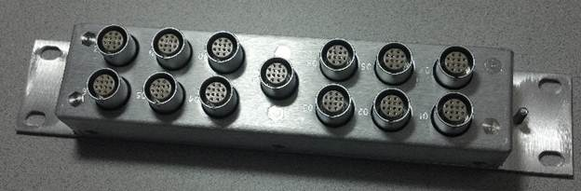
85556A 1x12 Fan-out Cable Splitter For operation with more than 4 CalPods
85556A CalPod 1x12 Fan-out cable splitter
All connectors are 12-pin female connectors
Notes:
The 85556A 1x12 Fan-out cable splitter is used when it is desired to control more than four Calpods from an 85523A Calpod controller. The 85556A is thermal-vacuum environment qualified, and is often used inside of a TVAC chamber.

Slide 11
Cabling to 85556A Fan-out Cable Splitter
When distance is < 2 meters between Calpod controller and cable splitter
CalPods
Up to 12 Calpods can be controller from one 85556A Calpod fan-out cable splitter
85552A 20 GHz CalPod drive cable
(2 meter length)
12 pin male to 9 pin male connectors
Or
85553A 40 GHz CalPod drive cable
(2 meter length)
12 pin male to 9 pin male connectors
85556A CalPod Fan-out cable splitter
All connectors are 12 pin female
85555A Splitter drive cable, 2 meters
12 pin male to 12 pin male connectors
(Always required for use with 85556A)

Slide 12
Cabling to 85556A Fan-out Cable Splitter
When a long distance is required from Calpod controller to cable splitter
CalPods
85552A 20 GHz CalPod drive cable
(2 meter length)
12 pin male to 9 pin male connectors
Or
85553A 40 GHz CalPod drive cable
(2 meter length)
12 pin male to 9 pin male connectors
85556A CalPod Fan-out cable splitter
All connectors are 12 pin female
85554A CalPod drive extension cable, 10 meters
12 pin male to 12 pin female connectors
85555A Splitter drive cable, 2 meters
12 pin male to 12 pin male connectors
(always required with 85556A)
Notes:
For distances > 10 meters from the 85523A Calpod controller to the 85556A Calpod fan-out cable splitter, the 85554A Calpod drive extension cables can be cascaded.

Slide 13
Cabling to 85556A Fan-out Cable Splitter
When a long distance is required from CalPod splitter to the CalPods
CalPod
85554A CalPod drive extension cable, 10 meters
12 pin male to 12 pin female connectors
85552A 20 GHz CalPod drive cable
(2 meter length)
12 pin male to 9 pin male connectors
Or
85553A 40 GHz CalPod drive cable
(2 meter length)
12 pin male to 9 pin male connectors
85556A CalPod Fan-out cable splitter
All connectors are 12 pin female
85554A CalPod drive extension cable, 10 meters
12 pin male to 12 pin female connectors
85555A Splitter drive cable, 2 meters
(always required with 85556A)
12 pin male to 12 pin male connectors

Slide 14

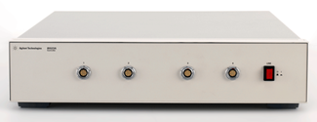
Controlling up to 48 CalPods from one Controller
Up to 12 CalPods can be controlled from each 85556A 1x12 Fan-out splitter
85556A 1x12 Fan-out splitter
85523A
CalPod Controller
CalPods
855552A or 85553A
CalPod Drive Cables
(2 meter length)
These cables need to be either the 85555A splitter drive cable (2 meters in length) or
The 85554A plus the 85555A cables for a total length of 12 meters
Notes:
Each 85556A 1x12 Fan-out splitter can drive up to 12 Calpods, and one 85523A Calpod controller can drive up to four 85556A 1x12 Fan-out splitters, so up to 48 Calpods can be controlled from one 85523A Calpod controller.

Slide 15
Multi-port CalPod System
RF Switch matrix
Microwave test cables
USB to LAN interface
1x12 Fan out
Cable splitter
1x12 Fan out
Cable splitter
These cables need to be either the 85555A splitter drive cable (2 meters in length) or
The 85554A plus the 85555A cables for a total length of 12 meters
Multi-port CalPod system uses firmware option 302, and re-corrects four Calpods at a time. See notes for information on how to re-correct multi-channel systems.
Notes:
Multi-port Calpod systems typically have the RF switching matrix outside of the environmental or TVAC chamber to ensure that the environmental changes do not affect the switch matrix.
Multi-port Calpod systems currently operate with firmware option 302, which allow re-correcting up to four Calpods at a time. For a multi-port Calpod system, Option 302 firmware allows control of up to four CalPods at a time, and we can use option 302 firmware to re-correct up to four CalPods, then switch the CalPod assignments, and then re-correct another four CalPods, and continue this process until all the CalPods and channels have been re-corrected. This control and re-correction can be accomplished programmatically, which makes this quasi multiple-channel operation easier for the operator.
The procedure is to set up a channel for up to four CalPods, assign four CalPod serial numbers to this channel, re-correct these four CalPods, then set up a second channel, assign the next four CalPod serial numbers, and then re-correct these next four CalPods. Continue this process until all the CalPods and channels are re-corrected.
To illustrate how this would work from the PNA front key panel: Cal, [More], [CalPod], [CalPod…]. This brings up the ‘Calibration Refresh Module Configuration’ dialog box. Set the CalPod assignments as:
PNA port #1: assign CalPod serial # 1 to this port
PNA port #2: assign CalPod serial #2 to this port
PNA port #3: assign CalPod serial #3 to this port
PNA port #4: assign CalPod serial #4 to this port
Then ‘Re-correct all (four) channels
Then programmatically change the RF switch matrix, and change the CalPod assignments as:
PNA port #1: assign CalPod serial # 5 to this port
PNA port #2: assign CalPod serial #6 to this port
PNA port #3: assign CalPod serial #7 to this port
PNA port #4: assign CalPod serial #8 to this port
Then ‘Re-correct all (four) channels
Repeat this process until all the CalPods have been re-corrected.
Keep in mind that if this is set up programmatically, this simplifies the process each time a re-correction of all the CalPods are desired.

Slide 16
Multi-port CalPod System
Optional 85554A 10 meter CalPod drive cable extension
.
.
.
Microwave test cables
85552A 20 GHz CalPod drive cable (2 meters) or
85553A 40 GHz CalPod drive cable (2 meters)
LAN to USB interface or LAN to LAN interface
85556A 1x12 Fan out
Cable splitter
85552A or
85553A
Female
connector
85555A Splitter Drive Cable, 2 meters
12 pin male to 12 pin male; 11 conductors
85554A 10 meter CalPod drive cable extension
12 pin Male to 12 pin female (uses 11 conductors)
Notes:
For CalPods used in a thermal vacuum chamber, the basic configuration is to have the 85523A CalPod controller outside the thermal vacuum chamber, and route the 85554A 10 meter CalPod drive cable extension through the TVAC chamber wall. We recommend that you purchase a 85554A 10 meter cable, cut it at the appropriate location, and solder the 11 conductors to a customer supplied hermetically sealed connector that penetrates the chamber wall. Most customers have their own unique connectors for this purpose. Then an 85555A splitter drive cable is required to interface the 85554A to the 85556A 1x12 fan out cable splitter. Then either the 85552A 20 GHz or 85553A 40 GHz CalPod drive cables (2 meter length) are connected from the fan out cable splitter to the CalPods. If a longer cable is required from the fan out splitter to the CalPod, another 85554A 10 meter CalPod drive cable extension can be used as shown above.
If more than 12 CalPods are required inside the chamber, a second 85554A 10 meter CalPod drive cable extension can be used to pierce the chamber wall (can add additional 10 meter sections on either side if desired) and then a second 1x12 fan out cable splitter can be placed inside the chamber. This can be repeated for up to four cable splitters inside the chamber. All cables are thermal-vacuum qualified, meaning that they can withstand the temperature extremes, and will not outgas in a hard vacuum.

Slide 17
Calpod Control Cables & Thermal Vacuum Chambers
Thermal-vacuum chamber
½ of 8554A Calpod drive extension cable
85555A Splitter drive cable
85555A Splitter drive cable
½ of 85554A Calpod drive extension cable
Notes:
When routing the Calpod control cables through a thermal-vacuum (TVAC) chamber wall, there is almost always a plate that can be used for routing different types of signals through to the inside of the chamber. DC bulkhead hermetically sealed connectors can be used to route the Calpod control signals through to the inside of the TVAC chamber. These DC signals are ± 15 VDC. The 10 meter 85554A Calpod drive extension cable can be used to route the control signals. Typical use will require the 10 meter 85554A Calpod drive extension cable to be cut at the appropriate length, and soldered to the pins of the hermetically sealed bulkhead connector on each side of the chamber wall. There are 12 DC conductors in the 85554A Calpod drive extension cable.
A DC hermetically sealed bulkhead connector that has been used by several different users in this application as 15 pin connector part number SP37/13-E-15-20-DSUB-DSUB provided by Pave Technology, 2751 Thunderhawk Court, Dayton, OH 45414-3445, telephone (937) 890-1100, FAX (937) 890-5165, or www.pavetechnology.com There are many other vendors and types of hermetically sealed connectors for this purpose as well.

Slide 18
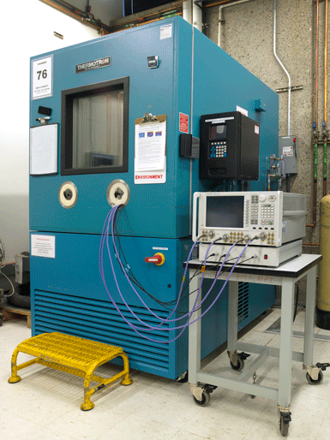
Calpod Control Cables & Thermal Chambers
Thermal chambers typically have large holes that have a foam plug. Both the RF and Calpod control cables are typically routed through these holes in the temperature chamber, and then have the foam plug inserted, as shown in this photo

